Slide 1
Welcome to Programming

Slide 2
Learning Goals
What is coding? | Here in this course we will know what it means to code and become a “hacker”
Python 3.9 | There are many different coding languages just like in real world there are hundreds of languages in this course we will be using and learning about python version 3.9
Assignments | You will be given optional tasks and programming assignments both in class and out side to hone your coding skills.
Change your POV about technology | Hopefully after this course the way you view the technology we have will change and eventually you will create the new technology to come.
Basics of programming | How to write clean code, how to design projects, and how to analyze code.

Slide 3
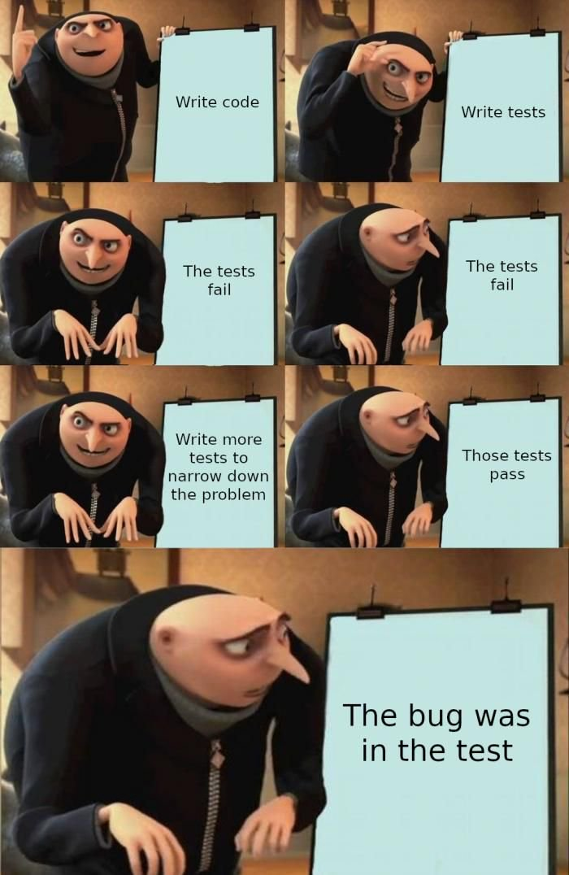
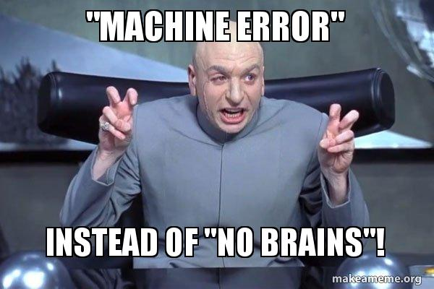

Firstly machines are dumber than you think……they are just faster.

Slide 4
Installing Visual Studio Code
Go here
Open visual studio code
01
03
download
Install extensions
02
04
https://code.visualstudio.com
Follow the instructions to make new project.
Make sure you download the correct version (MacOS vs Windows)
Python,prettier, indent-rainbow

Slide 5
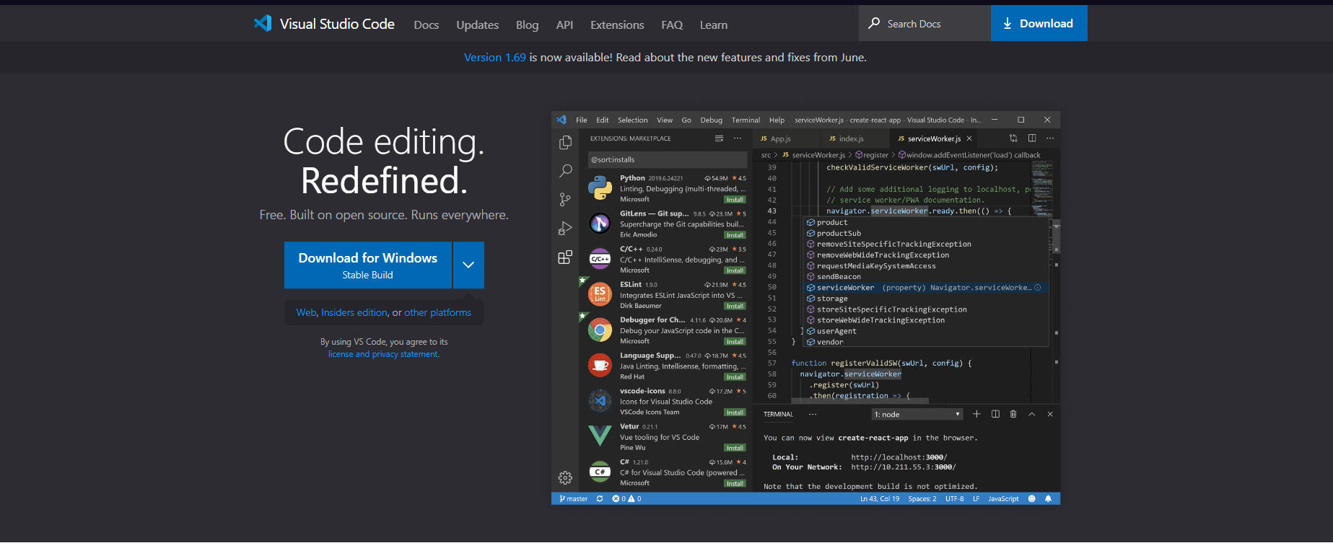

Slide 6
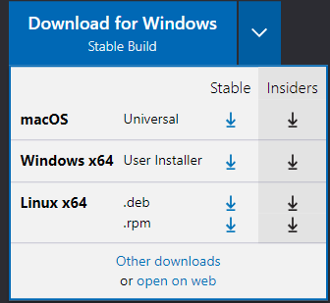

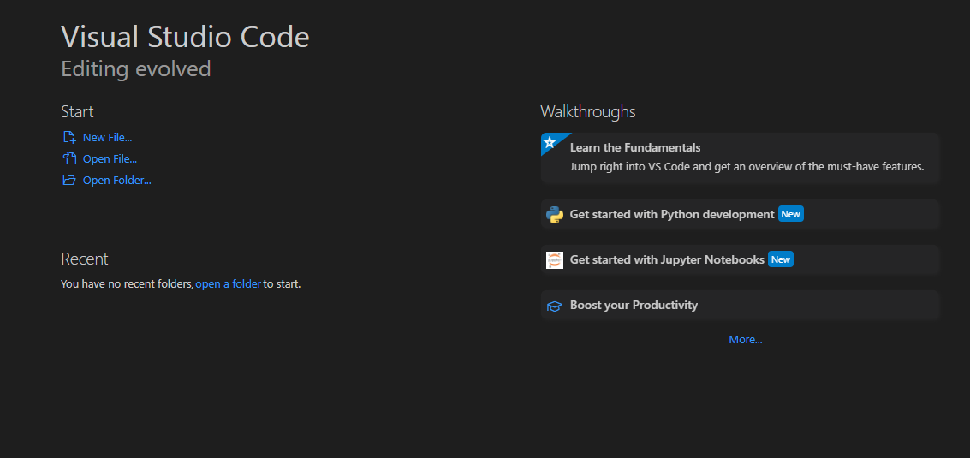
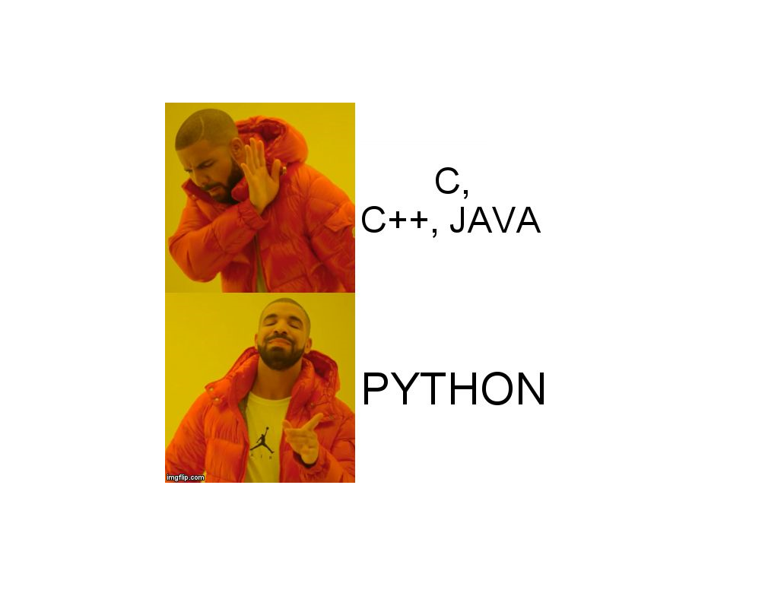

Slide 7
01
First project

Slide 8
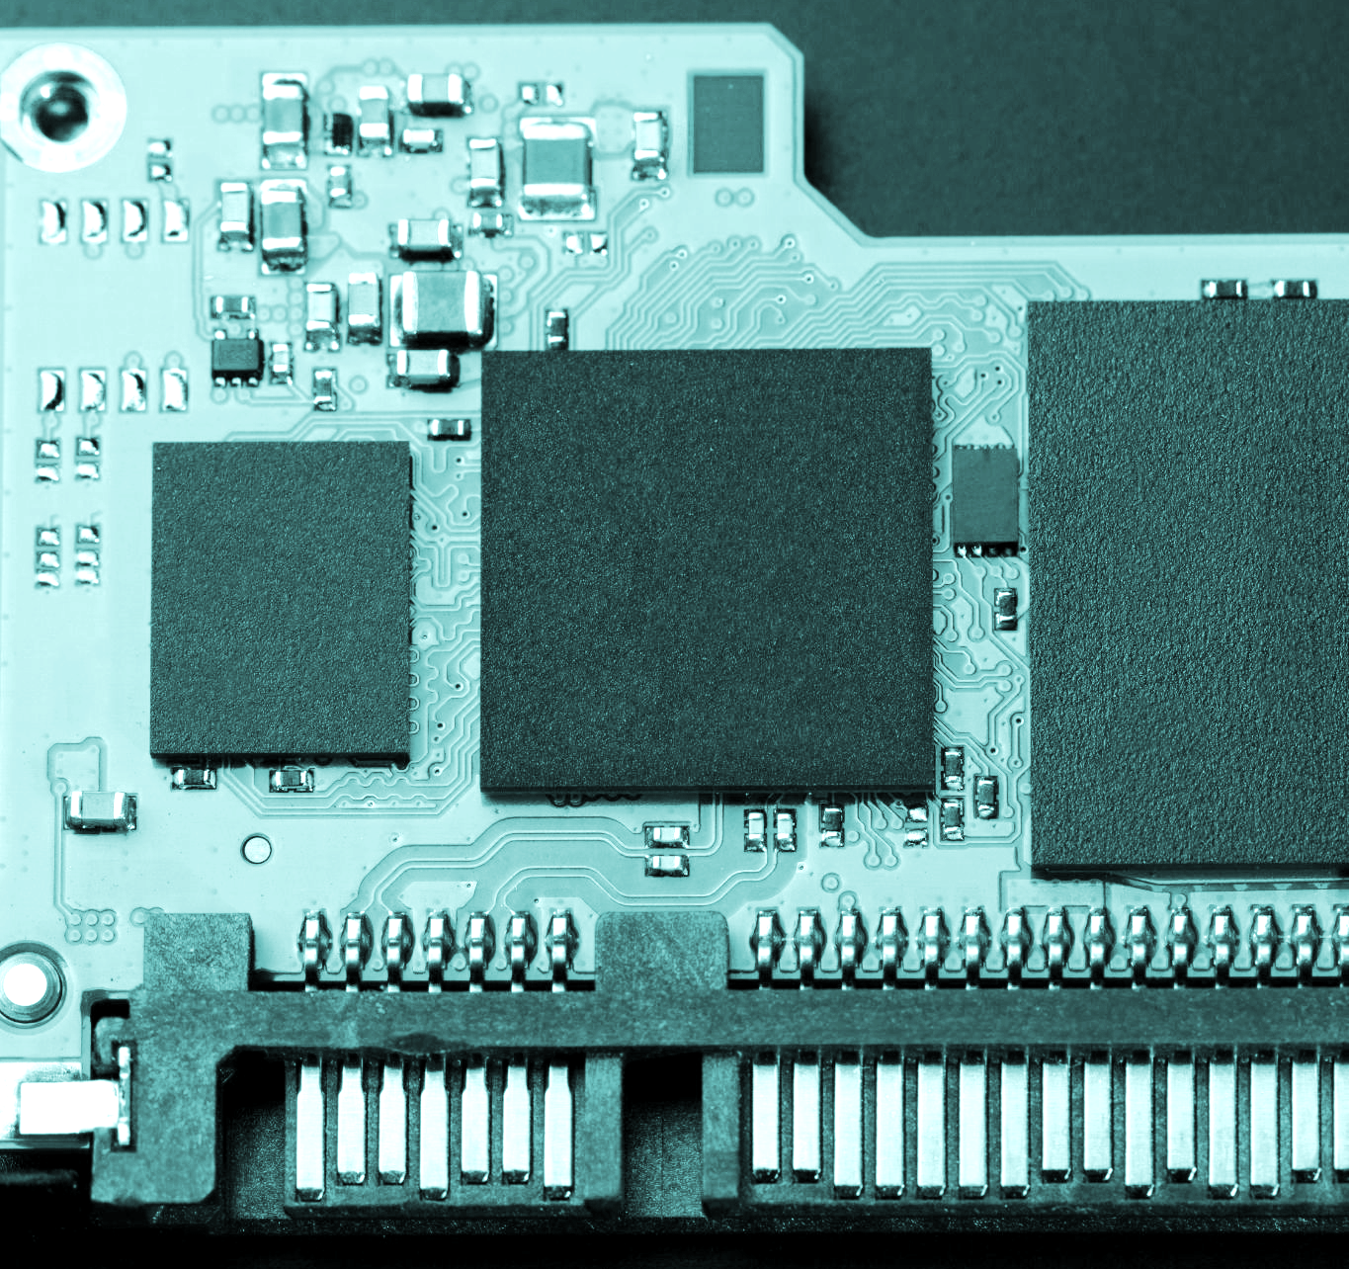
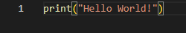
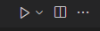
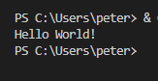
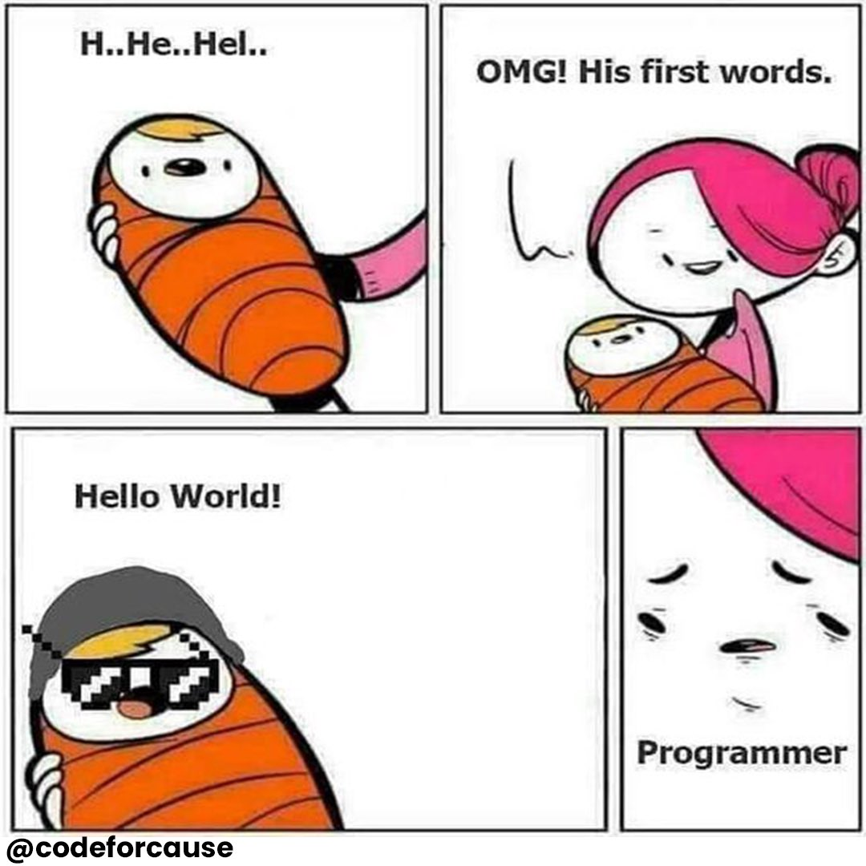
Hello World!
For our very first program we will make simple hello world program.
Very simple
After writing your code
Let’s run it!

Slide 9
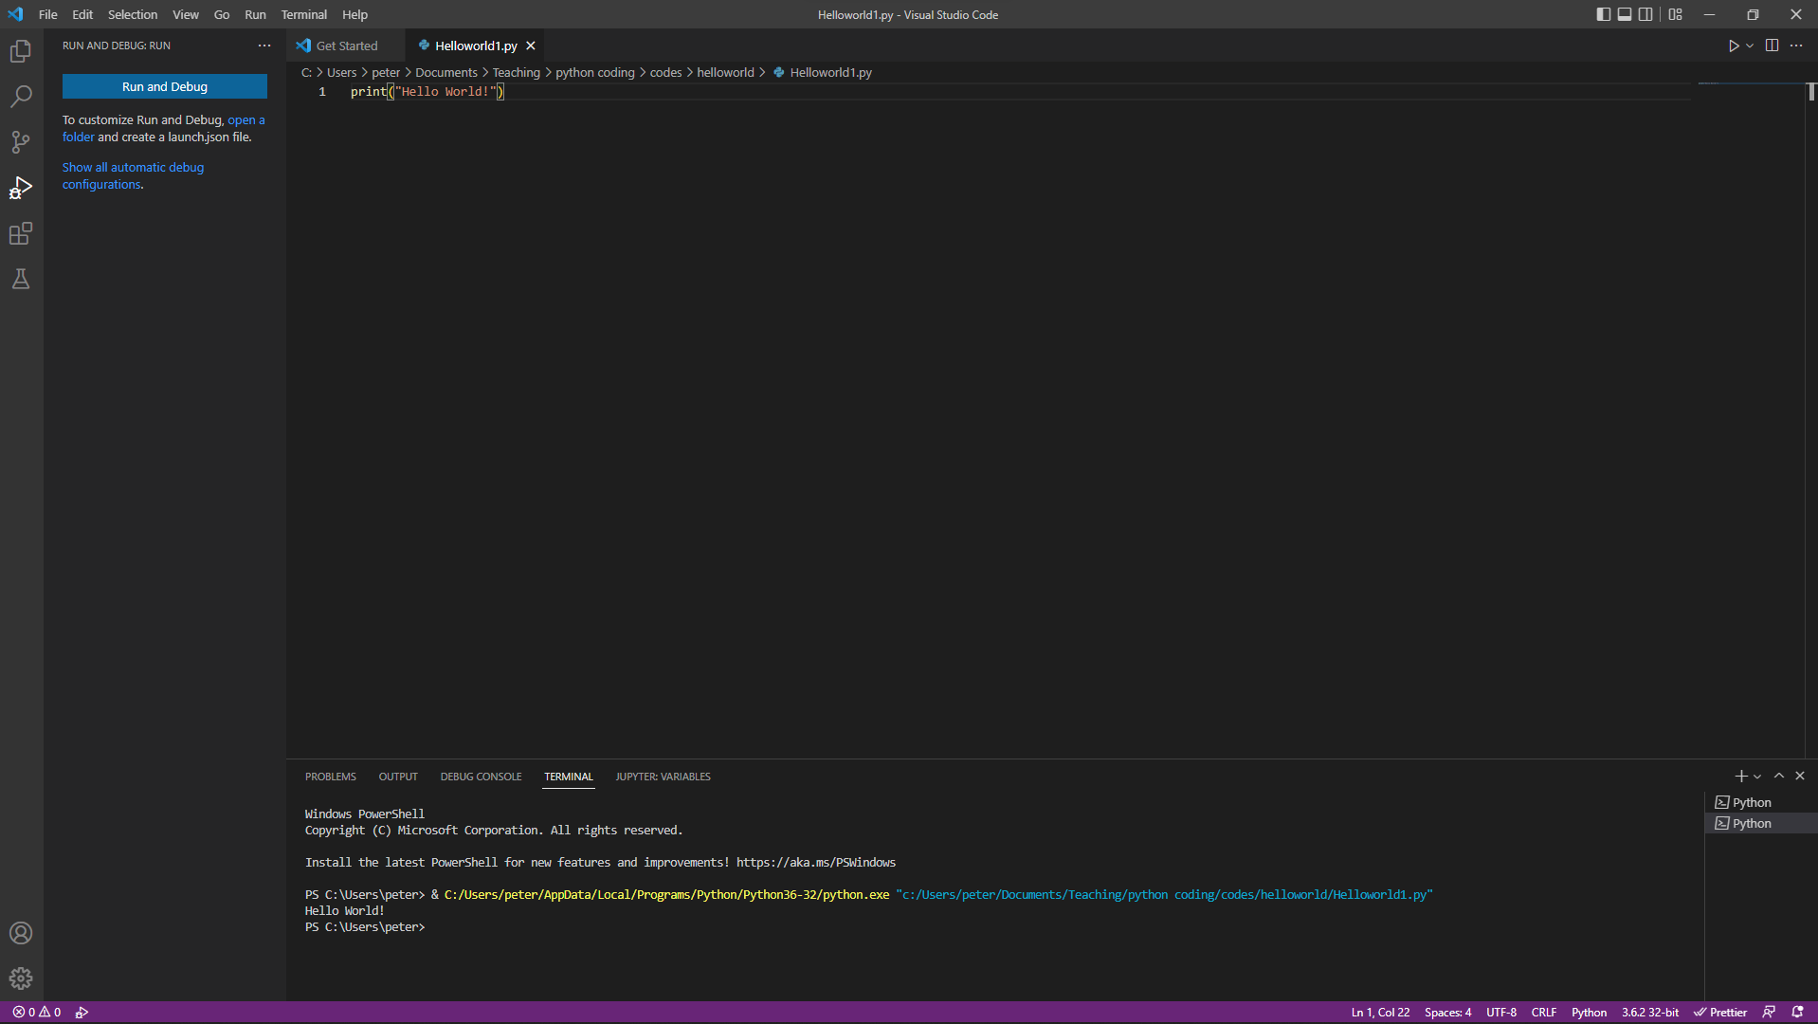

Slide 10
What did we just do?
Print( )
“Hello World”
Print is the name of a “function” just like in math a function takes in an input and “outputs” something in return.
“Hello World” was inside the bracket which is the “input” of the function.

Slide 11
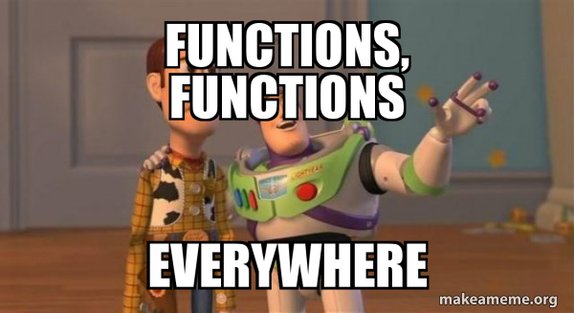
Some definitions.
Functions
Coding is composed of many functions, some are already written already for us to use for example “print()” function took inputs from the user(us) “Hello World”. Then the prewritten function wrote the same message to the console.
Input/Output
Inputs and outputs are exactly the same as in math. But they can interact with each other. And some functions sometimes don’t need input nor they need to return and outputs.

Slide 12
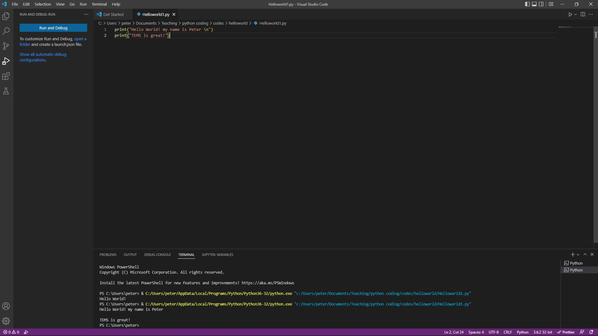
Let’s modify the code!

Slide 13
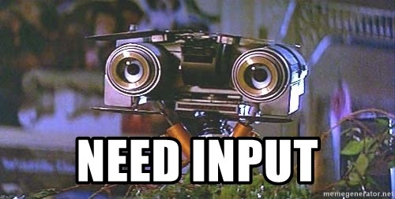
How to have varying input.
So far we had to physically type in the message in the “print()” function but what if we need to have custom message every time we use the program? Remember how we said that machines are dumber than we think? We also have to tell the machine what to do with the input as well.

Slide 14
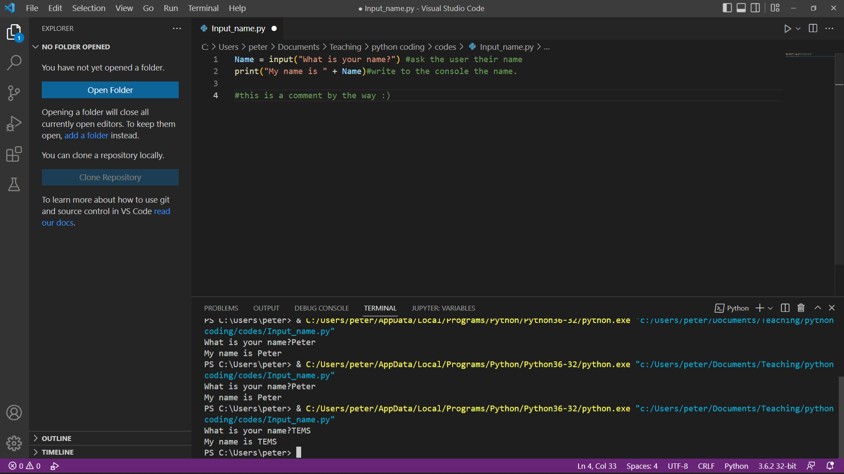
The “input” function
Input
As the name of the function implies It will output the question to the console asking the user a simple question and take that input data and store it in as “variable”

Slide 15
Definitions
Variable
Just like in math again variable can be anything. In programming variables are just like that but it can be more than just numbers. Think of it as a container and we can put anything into the container, as long as we label the container.
In the previous example we named a variable (the container) “Name” by default this container will contain “string”(we will get into what this is later). Then in the next line after “my name is “ we added “+” to “add” the variable “Name” into the message.
Lastly if you have noticed there are random messages after “#” signs. They are called comments. They can be very useful as you can write anything but usually a good coder will use this to explain what each command of line is doing.

Slide 16
01
First assignment

Slide 17
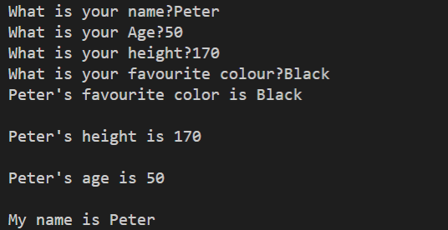
Take inputs from the user asking their Name, Age, height, and their favourite colour.
Simply then output the data using appropriate variable name, in reversed order.
Example of output. (to skip a line “\n” is used to break lines)

